Slide 1


General Biology
Lecture 4
Dr. Rawa Abdul Redha Aziz
Ph.D Antibiotics/ Molecular biology

Slide 2
Chemistry of life
To understand the mechanism of life, or how living organisms manage to reproduce, grow, move, think, eat and do whatever it is that they are doing, biologists can apply chemistry and physics to the study of life. The important foundation for any biologist who wants to understand molecular mechanisms underlying all life are based on understanding following observations: Six elements - carbon, hydrogen, oxygen, nitrogen, phosphorus and sulfur - make up 96% of all molecules of life

Slide 3
Biological polymers
Many biological molecules consist of basic units that are strung together to form long chains, much like beads are placed on a string to make a necklace. There can be some variation in these basic units, which are known as monomers. Two monomers connected to each other are known as a dimer; a chain of monomers is called a polymer. Natural polymers are used to build tissue and other components in living organisms. There are four basic kinds of biological macromolecules (polymers). They are carbohydrates, lipids, proteins and nucleic acids.

Slide 4
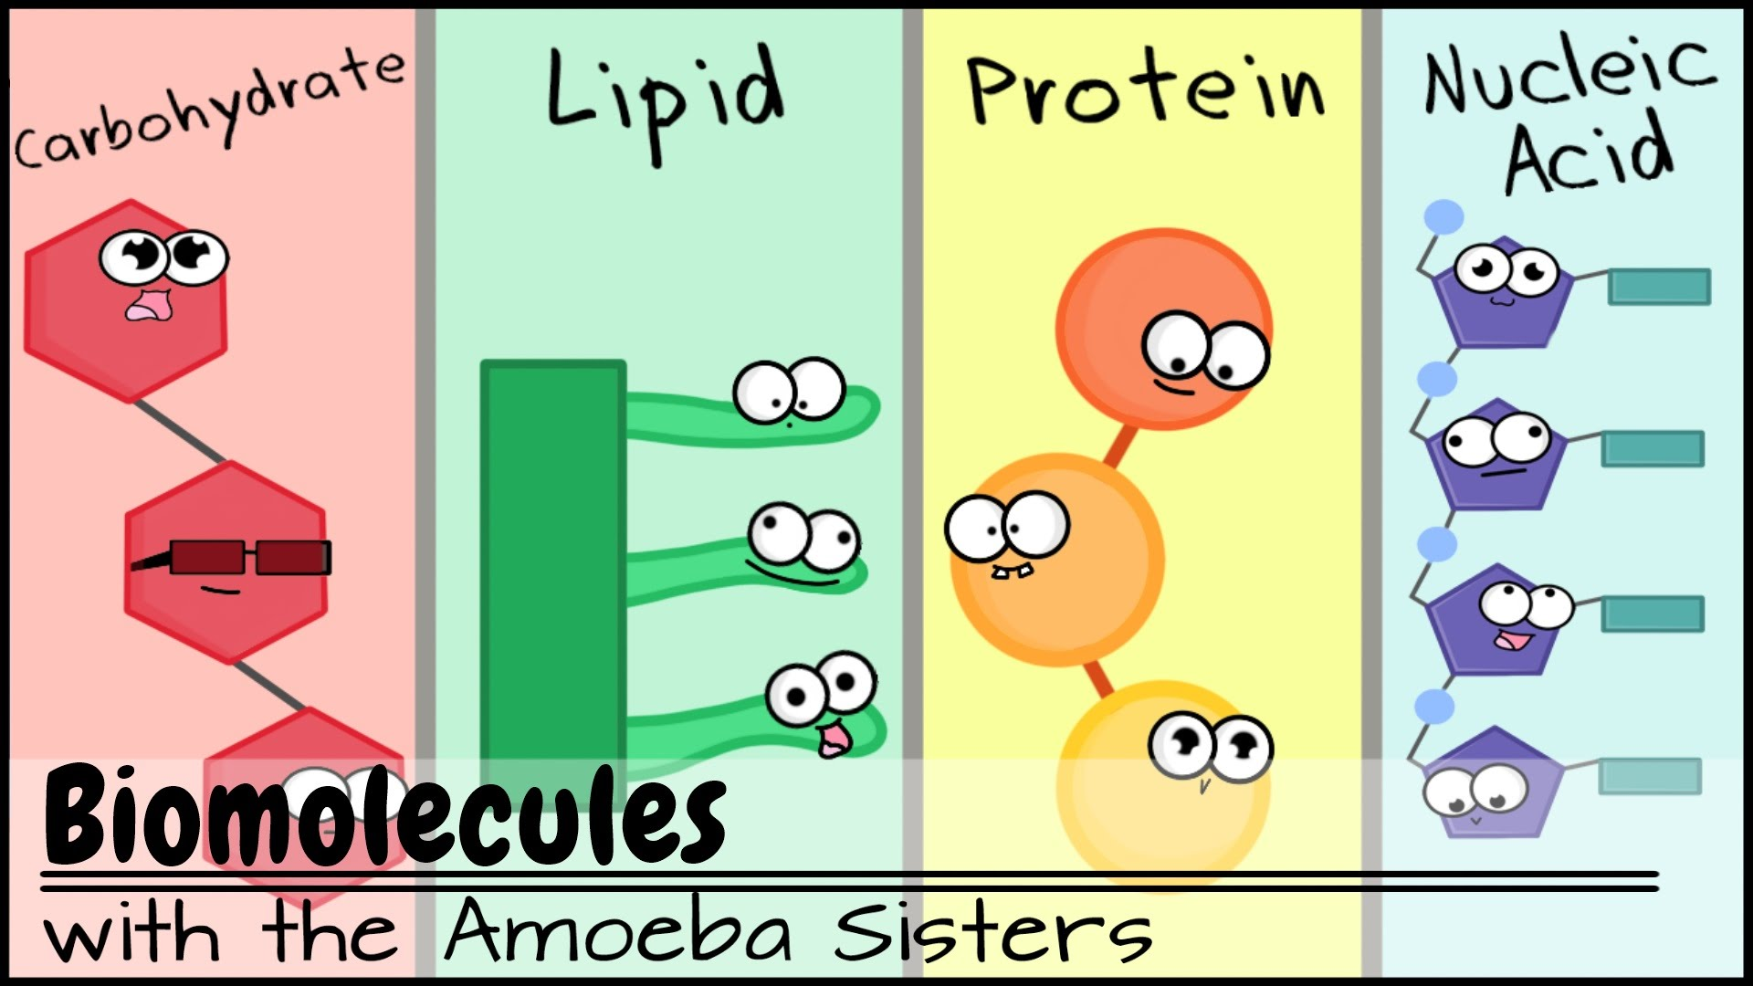

Slide 5
Carbohydrates are one of the four major classes of organic compounds in living cells. They are produced during photosynthesis and are the main sources of energy for plants and animals. The term carbohydrate is used when referring to a saccharide or sugar and its derivatives. Carbohydrates can be simple sugars or monosaccharides, double sugars or disaccharides, composed of a few sugars or oligosaccharides, or composed of many sugars or polysaccharides.

Slide 6
Monosaccharides: simple sugar has a formula that is some multiple of CH2O. For instance, glucose (the most common monosaccharide) has a formula of C6H12O6. Glucose is typical of the structure of monosaccharides . Glucose is an important energy source in living organisms. During cellular respiration, the breakdown of glucose occurs in order to release its stored energy.
Disaccharides: Two monosaccharides joined together by a glycoside linkage is called a double sugar or disaccharide. The most common disaccharide is sucrose. It is composed of glucose and fructose. Sucrose is commonly used by plants to transport glucose from one part of the plant to another. Disaccharides are also oligosaccharides. An oligosaccharide consists of a small number of monosaccharides units (from about two to ten) joined together. Oligosaccharides are found in cell membranes and assist other membrane structures called glycolipids in cell recognition.

Slide 7
Polysaccharides: can be composed of hundreds to thousands of monosaccharides combined together. These monosaccharides are joined together through dehydration synthesis. Polysaccharides have several functions including structural support and storage. Some examples of polysaccharides include starch, glycogen, cellulose, and chitin.
Starch is a vital form of stored glucose in plants. Vegetables and grains are good sources of starch. In animals, glucose is stored as glycogen in the liver and muscles.
Cellulose is a fibrous carbohydrate polymer that forms the cell walls of plants. It composes about one-third of all vegetable matter and cannot be digested by humans.
Chitin is a tough polysaccharide that can be found in some species of fungi. Chitin also forms the exoskeleton of arthropods such as spiders, crustaceans, and insects. Chitin helps to protect the animal's soft internal body and helps to keep them from drying out.

Slide 8
Lipids: are very diverse in both their respective structures and functions. These diverse compounds that make up the lipid family are so grouped because they are insoluble in water. They are also soluble in other organic solvents such as ether, acetone, and other lipids. Lipids serve a variety of important functions in living organisms. They act as chemical messengers, serve as valuable energy sources, provide insulation, and are the main components of membranes. Major lipid groups include fats, phospholipids, steroids, and waxes
1. Fats are composed of three fatty acids and glycerol. These so called triglycerides can be solid or liquid at room temperature. Those that are solid are classified as fats, while those that are liquid are known as oils. Depending on their structure, fatty acids can be saturated or unsaturated.
Saturated fats raise LDL (low-density lipoprotein) cholesterol levels in the blood. This increases the chances for developing cardiovascular disease. Unsaturated fats lower LDL levels and reduce the risk for disease. While fats have been denigrated to the point that many believe that fat should be eliminated from the diet, fat serves many useful purposes. Fats are stored for energy in adipose tissue, help to insulate the body, and cushion and protect organs

Slide 9
Phospholipids are composed of two fatty acids, a glycerol unit, a phosphate group and a polar molecule. The phosphate group and polar head region of the molecule is hydrophilic (attracted to water), while the fatty acid tail is hydrophobic (repelled by water). When placed in water, phospholipids will orient themselves into a bilayer in which the nonpolar tail region faces the inner area of the bilayer. The polar head region faces outward and interacts with the water. Phospholipids are a major component of cell membranes, which enclose and protect the cytoplasm and other contents of a cell. Phospholipids are also a major component of myelin, a fatty substance that is important for insulating nerves and speeding up electrical impulses in the brain.

Slide 10
Steroids and Waxes: Steroids include cholesterol, sex hormones (progesterone, estrogen, and testosterone) produced by gonads and cortisone. Waxes : Many plants have leaves and fruits with wax coatings to help prevent water loss. Some animals also have wax-coated fur or feathers to repel water.

Slide 11
Proteins: are large biomolecules, or macromolecules, consisting of one or more long chains of amino acid residues. Proteins perform a vast array of functions within organisms, including catalyzing metabolic reactions, DNA replication, responding to stimuli, and transporting molecules from one location to another. All proteins are typically constructed from one set of 20 amino acids. Examples of proteins include antibodies, enzymes, and some types of hormones (insulin).
AMINO ACIDS
Most amino acids have the following structural properties: A carbon (the alpha carbon) bonded to four different groups:
A hydrogen atom (H)
A Carboxyl group (-COOH)
An Amino group (-NH2)
A "variable" group
PROTEIN STRUCTURE
There are two general classes of protein molecules: globular proteins and fibrous proteins:
Globular proteins: Are generally compact, soluble, and spherical in shape. Globular proteins like hemoglobin.
Fibrous proteins: Are typically elongated and insoluble, collagen and keratin are fibrous and stringy.

Slide 12
PROTEIN SYNTHESIS
Proteins are synthesized in the body through a process called translation. Translation occurs in the cytoplasm and involves the rendering of genetic codes that are assembled during DNA transcription into proteins. Cell structures called ribosomes help translate these genetic codes into polypeptide chains. The polypeptide chains undergo several modifications before becoming fully functioning proteins

Slide 13
Nucleic Acids: molecules consisting of nucleotide monomers linked together to form polynucleotide chains. DNA and RNA are examples of nucleic acids. These molecules contain instructions for protein synthesis and allow organisms to transfer genetic information from one generation to the next. Nucleotides contain three parts:
* A Nitrogenous Base (Adenine, Guanine, Cytosine, Thymine and Uracil ).
* A Five-Carbon Sugar (Deoxyribose in DNA , Ribose in RNA ).
* A Phosphate Group.
DNA is the cellular molecule that contains instructions for the performance of all cell functions. When a cell divides, its DNA is copied and passed from one cell generation to the next generation. DNA is organized into chromosomes and found within the nucleus of our cells.
RNA is essential for the synthesis of proteins. Information contained within the genetic code is typically passed from DNA to RNA to the resulting protein.

Slide 14

Any Question?

